Slide 1
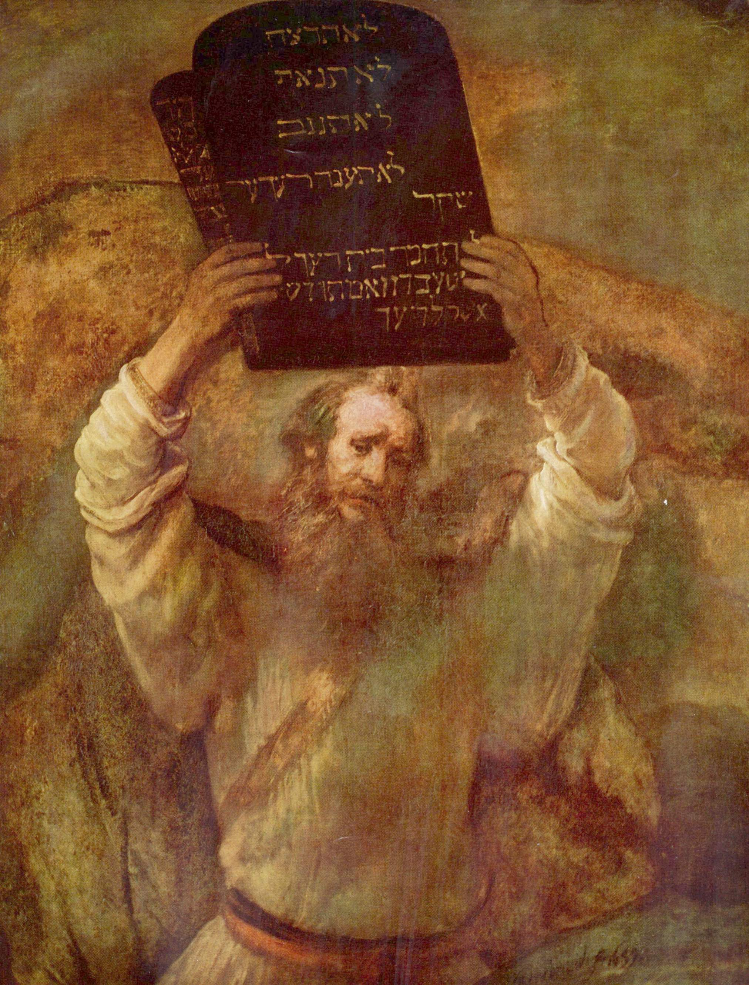
Guest Lecture on Ethics for Engineering Students
Stephan Kinsella
C4SIF.org • StephanKinsella.com
@nskinsella
BSEE, MSEE, JD, LL.M.
CU Boulder
EMEN 4100: Engineering Economics (Lecturer: David Assad)
Dec. 11, 2024

Slide 2
Ethics, Morality, Politics, and Science
Today I’ll discuss one approach to understanding ethics and its relationship to science and politics

Slide 3
Science: Different Types
Nowadays we think of “science” as the study of causal laws following the scientific method
Physics, chemistry, biology, related fields like engineering, mathematics
Other disciplines are considered “unscientific”: the arts, philosophy, etc.
Because they are not testable, not quantifiable, there is sometimes a “subjective” aspect
Some disciplines are considered soft sciences, not rigorous
Psychology, sociology
Economics used to be a non-quantitative discipline studying the consequences of purposive human action and interaction related to the production of wealth

Slide 4
Science: Different Types
“Science” used to be a broad term that could encompass both the natural sciences (which study causal laws) and teleological phenomenon—those related to purposive human action:
Science, from Latin scientia or “knowledge”
Scienter, conscience (“with knowledge”)
US Constitution: “The Congress shall have Power . . . ] To promote the Progress of Science and useful Arts, by securing for limited Times to Authors and Inventors the exclusive Right to their respective Writings and Discoveries.”
Science | useful Arts
Authors | Inventors
Writings | Discoveries

Slide 5
Science: Different Types
In past ages any systematic study of a topic was viewed as a science: not only the causal or natural sciences, but morality or ethics, aesthetics, and so on.
The success of the causal natural sciences (physics, chemistry etc.) led to the rise of logical positivism and empiricism
Karl Popper
The elevation of the “scientific method” as “real science”
Economics started adopting the methods of the natural sciences—doing falsifiable experiments, econometrics, formulating economic laws in the form of mathematical equations—to appear to be “scientific”
The Austrian school of economics most sound view of the distinct sciences pertaining to different realms of knowledge, and critical of the monism of the current dominant empiricism
Ludwig von Mises, Ultimate Foundation of Economic Science
Hans-Hermann Hoppe, Economic Science and the Austrian Method, A Theory of Socialism & Capitalism, Economics & Ethics of Private Property, The Great Fiction (https://hanshoppe.com/publications/)

Slide 6
Types of Laws
A “science” is any systematic study of a realm of phenomena
Attempt to explain the general laws of that field
Laws can be descriptive (factual) or prescriptive (normative)
Descriptive:
Physics/causal (gravity)
Economics (supply and demand)
Though there is dispute about the nature of economic laws
Mainstream economics views economic laws as empirical and subject to testing
Austrian and classical economics viewed the laws as verbal, non-quantitative, and deductive (a priori)

Slide 7
Types of Laws
Prescriptive/Normative:
Moral/ethical laws: virtue, honesty, right and wrong, shoulds and oughts
Personal norms aimed at guiding individual behavior
Legal rules (theft, murder), “laws” or “legal laws” or “juridical laws”
Must versus should
Enforceable
Lady Justice (Themis)
(impartiality)
Sword (enforcement)
Scales of justice (balance of the parties’ interests)
Politics pertains to meta-ethical norms that tell us what laws are just
Not aimed at individual behavior as ethics and morals are, but tell us which types of laws we should support, which types of laws are just
Douglas B. Rasmussen & Douglas J. Den Uyl, Liberty and Nature: An Aristotelian Defense of Liberal Order (La Salle, Ill.: Open Court, 1991); idem, Norms of Liberty: A Perfectionist Basis for Non-Perfectionist Politics. Pennsylvania State University Press, 2005

Slide 8
Ethics and Morality
Morality and the virtues can apply even to someone living alone on an island
To live a good life on the island, you should not be lazy
You should plan for the future
But these morals are not interpersonal
When we live in society, many ethical rules have to do with the right and wrong of interacting with other people
Some actions are just wrong
Being rude to your grandmother
Being impolite
Some are so wrong that they should be made illegal
Murder, theft

Slide 9
Ethics and Morality
We are used to everyday ethical situations, dilemmas, and so on

Slide 10
Ethics and Morality
Ethics can be studied systematically
Morality is the philosophical science that aims to provide guides to human behavior
A code of morals that instructs people as to how to act so as to achieve meaningful values
Classically, those values that are appropriate to living as a human according to his nature, those appropriate to human flourishing; eudaimonia
“Ethics” is an ambiguous term.
Sometimes it is synonymous with morality, or right and wrong
Sometimes it is a narrow set of norms that pertain to a given profession
Legal ethics
Medical ethics
This is not universal

Slide 11
Ethics and Morality
Here we will explore ethics in the sense of morality, not narrow ethics for special fields
And we will then touch on its extension to politics, i.e., the metanorms of political philosophy
Finally we will discuss one field of law, intellectual property

Slide 12
Different Views on Ethics
You will all be familiar with some version of ethics or morality
Various approaches:
Consequentialism
utilitarianism (a subset of consequentialism)
Randy E. Barnett, “Of Chickens and Eggs—The Compatibility of Moral Rights and Consequentialist Analyses,” Harv. J. L. & Pub. Pol’y 12 (1989): 611–36, and idem, “Introduction: Liberty vs. License,” in The Structure of Liberty: Justice and the Rule of Law, 2d ed. (Oxford, 2014)
Natural rights/natural law
Virtue ethics
Kantian/deontological ethics, duty ethics
Relativism
Contractarianism
Egoism/rational selfishness (Ayn Rand)
Hedonism, narcissim, nihilism

Slide 13
Different Views on Ethics
Reason versus Authority
Where your morals or ethics come from
From religion or God
From tradition
From experts
From the government
How do we know what is right and wrong?
Epistemology
Are morals and rights natural, based on human nature
Or relative and changing
Traditional, conservative, individualist, collectivist, religious, secular

Slide 14
Different Views on Ethics
Are morals pragmatic or principled?
Ayn Rand: rejected dichotomies
The practical is the moral, and vice-versa
Since man ought to live as a man, according to his nature, to flourish (eudaimonia)
Common elements to most ethics: pragmatic (practical) and intuitive norms
Prudence
Justice/fairness
Fortitude/courage
Temperance/restraint
Honesty
Integrity
Thrift
Hard work

Slide 15
Political Ethics/Political Philosophy
Based on one’s view of ethics, man’s nature, various political philosophies corresponding to different types of states, or political systems
Dictatorship/Totalitarianism/Despotism
Communism
Monarchy
Democracy/Republicanism/Constitutionalism
Socialism/welfare statism
Classical Liberalism (“Liberalism”)
Libertarianism
Minarchism
Anarcho-libertarianism or anarcho-capitalism

Slide 16
Classical Liberalism and Libertarianism
Constitutionalism
Limited government
Core, “night-watchman” functions
Courts, police, national defense
A few more, maybe roads, and so on
Minimal taxes and regulation
Not much else
Free trade with other nations
Anti-war, pro-peace, no entangling alliances, no foreign interference
Libertarianism
A more consistent, radical, and principled version of classical liberalism
Minarchy or “ultra-minimal state” (Robert Nozick, Anarchy and Utopia, 1974)
Anarchy: most consistent and principled variant
Law, courts, education, transportation, defense all private

Slide 17
Conflict, Scarcity and Property Rights
All political systems rest on a particular understanding of property rights
All rights are human rights, and all human rights just are property rights
Humans live in a world of scarcity
there is a possibility of conflict
between human bodies, and between scarce resources (means of action) that we need to use (possess) to survive
Because of the scarce and limited nature of resources and the possibility of conflict, and because humans needs to use their bodies and other resources to act in the world, property rights emerge to allocate owners to resources so that conflict can be avoided and resources can be used peacefully and productively instead of violent conflict, waste, destruction and fighting.

Slide 18
Property Rights, Law, and Political Systems
Law is the institutionalized protection of property rights
Every political system is based on some view of property rights and justice
The only real difference between systems is how private property rights and ownership are determined
In communism, theocracy, democracy, welfare-statism, socialism, capitalism, the political-legal system always has an answer to the question: who owns this resource
In the private law developed in the Roman Law (449BC–529AD) and the English Common Law (1066–today), the courts developed law by settling disputes (conflicts) between parties

Slide 19
Property Rights Under Private Law and Classical Liberalism
The basic rules against murder, assault and battery, rape, theft, are based on four simple rules:
Self-ownership, or body-ownership
Implicit in laws against murder, rape, slavery, assault
Every person is the presumptive owner of his own body
May be forfeited by committing crimes
Defensive force may be used against someone’s body in self-defense
Criminal may be enslaved or punished
For external, previously owned resources
The first-user (homesteader) is the presumptive owner
Or someone he transfers it to by contract
Or if a property owner harms someone else (tort) he may have to transfer some of his property to the victim for compensation or restitution (rectification)

Slide 20
Property Rights and Libertarianism
These core property rights are largely respected under the private law, but with many exceptions
Legislated exceptions
Deviations from common law and Roman private law
Taxation
Conscription
Regulations
Victimless crime laws
Drug war, blasphemy, prostitution
Bad laws that evolved on the common law
Defamation, trademark

Slide 21
Property Rights and Libertarianism
Libertarianism is a more consistent, principled, and radical version of classical liberalism
Makes no, or very few, exceptions, to the core property rights of self-ownership, homesteading, and contract
The most fundamental right is self-ownership (body-ownership)
Basically it is in opposition to slavery
To someone else using your body without your permission (consent)
Using it, hitting it, harming it, killing it
This is called aggression: the initiation of physical force against another’s body, without his consent
Libertarians oppose aggression: the unconsented-to use of another person’s body
We refer this rule as the non-aggression principle, but it is just another way of saying everyone is a self-owner

Slide 22
Property Rights and Intellectual Property
Let’s apply this libertarian perspective on property rights and justice to an issue that most people are confused about: intellectual property (IP)
IP includes legal regimes or rights that have to do with products of the mind
Inventions (patent law)
Creative works (copyright)
Product and company names and identifiers (trademark)
Useful confidential information (trade secret)
Patent and copyright are the two big ones and we will focus on them here

Slide 23
Property Rights and Intellectual Property
IP (patent and copyright) are grants by the state to an inventor or author to the exclusive use of the invention or work
Patent holder can sue someone “infringing” the patent by selling a similar device and stop him from selling or copying
17 years
Copyright holder can sue someone “infringing” the copyright by selling a similar book, movie, song, painting and stop them from selling of copying
Life of author + 70 years ≈ 100+ years
This reduces the competition faced by the seller so they are able to sell for higher prices: monopoly prices

Slide 24
Justifications for IP: Natural Rights
Natural rights and utilitarianism
Natural right to the “fruit of your labor” or to “things you create”
Many problems with this idea
Notice in the 4 basic principles we have property rights in our bodies (self-ownership) and in unowned external resources that someone first finds and homesteads (appropriation), or that is acquired by contract from a previous owner
It has nothing to do with creation
We do not create things out of thing, we rearrange owned input factors
This is what production is
Transformation of owned resources creates wealth but not property rights
You must own the resource first
Henry Ford workers do not own the cars they build

Slide 25
Justifications for IP: Natural Rights
Locke’s mistake: the idea that we own our labor
KOL037 | Locke’s Big Mistake: How the Labor Theory of Property Ruined Political Theory
Labor is just an action, like leisure
We do not own actions, actions are what we do with our bodies and other things we own
You come to own an unowned resource that you appropriate not because you own your labor but because you are first and have a better claim over the resource

Slide 26
Justifications for IP: Utilitarianism
With IP law to give an incentive to inventors and artists, we will get more innovation, invention, and creative works
The assumption is that on the free market, there will be an underproduction or sub-optimal production of creative works
Because it is “too easy” for a competitor to compete and copy or “knock you off”
Several faulty assumptions with this line of reasoning:
that it is the purpose of law to make sure there is “enough innovation” or to “maximize” innovation. It is not. The purpose of law is to do justice by defining and protecting property rights; (see my book, LFFS, Part IV et pass; Intellectual Property Discussion with Mark Skousen)
that when the state identifies market failure, such as the free market, in the absence of state-granted patent and copyright monopolies that protect producers from competition, the state has the right to intervene in the market to try to fix this market failure

Slide 27
Justifications for IP: Utilitarianism
faulty assumptions…
that the free market, absent IP monopolies granted by the state, produces a sub-optimal level of innovation
that the state can remedy this market failure by granting monopolies
that the state’s grant of IP monopolies has in fact stimulated or led to a greater amount of innovation, invention, and artistic works than otherwise (“The Overwhelming Empirical Case Against Patent and Copyright” and “Legal Scholars: Thumbs Down on Patent and Copyright,” in Kinsella, You Can’t Own Ideas)
that any additional innovation and creative works incentivized by the IP system are worth more to society than those lost or suppressed due to these same laws (“There’s No Such Thing as a Free Patent,” in You Can’t Own Ideas)
that even if IP law gives rise to a net gain to society in terms of extra innovation, invention, and creative works, that this net gain is greater than other costs of the iP system (“There’s No Such Thing as a Free Patent,” in You Can’t Own Ideas)

Slide 28
The Problem with IP
Natural rights and utilitarian justifications for IP make no sense
Return to the core property principles: the owner of a resource is the person who first appropriated it, or who obtained it by contract from a previous owner
Every self-owning person may use his body and owned resources however he wants—he may act—so long as he does not use the resources of another person without their consent
Kissing a girl with her permission or consent is fine; it is assault if she does not consent
Tackling someone in football or punching a boxer is not assault since it is consensual; tackling a stranger on the street is assault and battery

Slide 29
IP as Negative Easements
If I sell a copy of Harry Potter or a smartphone similar to an iPhone I have not used any of JK Rowling’s or Apple’s resources without their permission
There is no trespass
No invasion of the physical integrity of their property boundaries
Hoppe on Property Rights in Physical Integrity vs Value
In Homeowners Associations, neighbors enter into mutual negative easement agreements
Not to paint your house an ugly color or more than two stories
This is a contractual veto right granted to your neighbors,
Not to use your house but to prevent you from using it in certain ways
This is fine because it is consensual
It is agreed to

Slide 30
IP as Negative Easements
In the case of IP, the state grants a negative to an inventor or artist over the factories and printing presses of everyone else
This is a taking of the property rights of those affected by the patent or copyright
The patent and copyright are nonconsensual negative easements
Just as a football tackle is fine but an unconsented to attack is aggression, so a voluntary negative easement is fine but a nonconsensual negative easement imposed by the state is aggression and trespass against property rights
Intellectual Property Rights as Negative Servitudes

Slide 31
IP as Negative Easements
So you can see that having a clear understanding of the nature, basis, function, and origin of property rights helps to see the fundamental problem with IP rights
IP rights violate property rights
They are unjust and should be abolished
Copyright distorts culture, restricts freedom of speech and of the press
And threatens internet freedom (websites being shut down, youtube videos taken down)
“Copyright is Unconstitutional”
Patent law distorts and impedes innovation
Impoverishes the human race because the only reason we are richer than the Romans is the accumulation of technical knowledge

Slide 32
Further Reading: Libertarianism
Stephan Kinsella, Legal Foundations of a Free Society (Houston, Texas: Papinian Press, 2023; https://stephankinsella.com/lffs/)
Kinsella, The Greatest Libertarian Books, https://stephankinsella.com/lffs/
“Libertarian Legal Theory: Property, Conflict, and Society” (Mises Academy, 2011; 6 lectures) https://stephankinsella.com/kinsella-on-liberty-podcast/

Slide 33
Further Reading: IP
Critique of IP
Part IV of my book, LFFS
You Can’t Own Ideas: Essays on Intellectual Property (Papinian Press, 2023)
The Anti-IP Reader: Free Market Critiques of Intellectual Property (Papinian Press, 2023)
Other resources at https://c4sif.org/resources
“Rethinking Intellectual Property: History, Theory, and Economics” (Mises Academy, 2011; 6 lectures)
IP tutorials (on IP law)
KOL409 | IP Law Tutorial, Part 1: Patent Law
KOL411 | IP Law Tutorial, Part 2: Copyright Law
KOL412 | IP Law Tutorial, Part 3: Trademark, Trade Secret, and Other
https://c4sif.org/resources

